Slide 1


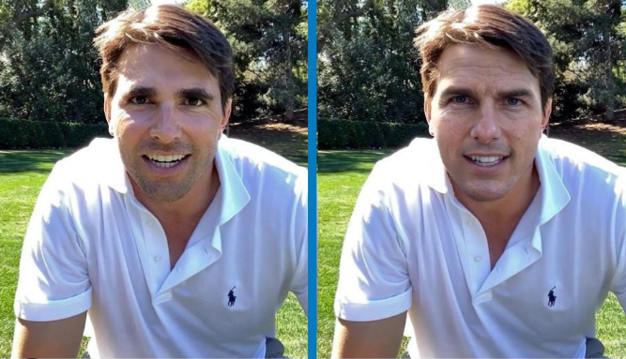
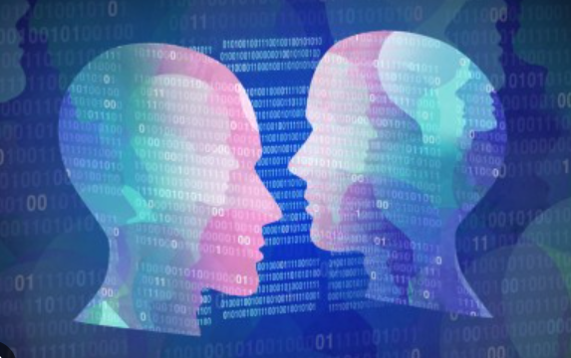
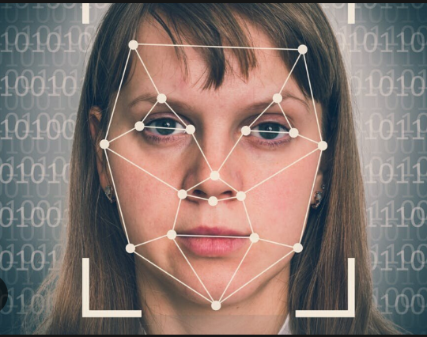
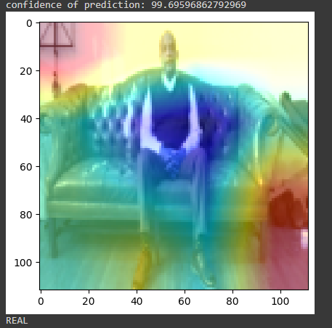
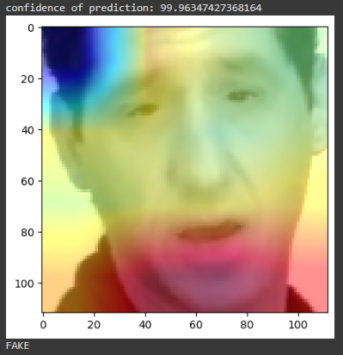



DEEPFAKE DETECTIVE
-Ruth Simon M80008145
-Sened Abraham M8008143
Supervisor-Maurice Danaher
Zayed University – College of Technological Innovation
INTRODUCTION
PROJECT OBJECTIVES
As AI technologies continue to advance at an unprecedented pace, their potential to revolutionize the way we live and work is becoming increasingly apparent. However, with these advancements comes a growing concern: the rise of deepfakes. Imagine a world where what you see is not what it seems. Deepfakes are videos or images that have been manipulated using machine learning algorithms to alter the appearance or speech of the individuals in them[1]. They have become a growing concern in recent years as they have the potential to manipulate public opinion, spread false information, and undermine trust in digital media. Deepfakes have the power to alter our perceptions and twist the truth. The ease with which deepfakes can be created and the increasing sophistication of these fake videos and images make it difficult to detect them[2]. This is where our project comes in. We aim to develop a solution that can detect and identify deepfakes with high accuracy, mitigating the potential harm they can cause and to make the digital world a safer place.
The primary objectives of the deepfake detective site are:
Provide an easy-to-use system for users to upload a video and distinguish whether a video is real or fake.
To protect individuals from harm: To lower possibilities of spreading false information, manipulate public opinion, undermine trust in digital media, broadcast fake news, manipulate evidence in legal cases.
To preserve trust: Deepfakes can erode trust in digital media, making it difficult for individuals to distinguish between what is real and what is fake.
To safeguard reputation: Deepfakes can be used to create fake videos or images that damage an individual's reputation.
RESULTS and ANALYSIS
To ensure real-time prediction of fake videos, we gathered data from the DFDC dataset and combined it with our own dataset. This resulted in a total of nearly 6,000 videos with two facial modification algorithms. Our goal was to improve the accuracy of our model on different types of videos. The first step in processing the videos was to split them into frames. We then detected the face in each frame and cropped it to include only the face. Finally, we combined the cropped frames to create a new video, disregarding any frames without faces. By using an equal ratio of 50% real and 50% fake videos, we avoided any training bias.
Our model uses a combination of CNN and RNN. Specifically, we utilized a pre-trained ResNext CNN model to extract features at the frame level, which were then fed into an LSTM network to classify the video as either real or fake. During training, we loaded the labels of the videos using the data loader on the training split and fit them into the model. We employed various libraries, such as torch, torchvision, numpy, and face recognition, to build and train our model. To provide a user-friendly interface for the users, we developed a website that allows the user to upload a video for prediction. The index.html page contains a tab that enables the user to browse and upload the video. Once the video is uploaded, it is passed through the model, and the output is displayed on the predict.html page. The model returns the output of whether the video is real or fake, along with the confidence of the prediction. The results show that the confidence of our model's predictions is over 90%.
CONCLUSIONS and FUTURE WORK
In conclusion, the development of a deepfake detective using artificial intelligence is an important step towards addressing the growing concern around the spread of deepfakes and their potential to harm individuals and society. The objective of this project is mainly designed to protect the truth, prevent harm to individuals, restore trust in digital media, support informed decision-making, protect democracy, promote transparency, and support the advancement of technology. The project’s main aim is to prepare a well refined to ensure that it performs well in real-world scenarios and therefore help protect individuals and society from the harmful effects of deepfakes.
As a future work, we aim to continue improving and increasing the accuracy of our model by exploring different training methods and techniques. One area of focus will be on incorporating the mechanism for detecting audio deepfakes developed in the paper "Who are you (I really wanna know)? detecting audio deepfakes ..." by Blue et al. The purpose of the cited paper is to develop a mechanism for detecting audio deepfakes using techniques from the field of articulatory phonetics[2]. Specifically, the paper applies fluid dynamics to estimate the arrangement of the human vocal tract during speech generation and shows that deepfakes often model impossible or highly-unlikely anatomical arrangements. By parameterizing the mechanism to achieve 99.9% precision, the detection mechanism achieves a recall of 99.5%, correctly identifying all but one deepfake sample in the dataset. The paper demonstrates that subtle, but biologically constrained aspects of how humans generate speech are not captured by current deepfake models, and can therefore act as a powerful tool to detect audio deepfakes.
REFERENCES
[1] Aldwairi, M., & Alwahedi, A. 2018. Detecting Fake News in Social Media Networks. Procedia Computer Science, https://doi.org/10.1016/j.procs.2018.10.171
[2]BLUE, L. (2022). Who are you (I really wanna know)? detecting audio deepfakes ... - usenix. Retrieved April 24, 2023, from https://www.usenix.org/system/files/sec22fall_blue.pdf
[3] Cross, C. (1970) Using artificial intelligence (AI) and deepfakes to deceive victims: The need to rethink current romance fraud prevention messaging: Semantic scholar, Crime Prevention and Community Safety. Available at: https://www.semanticscholar.org/paper/Using-artificial-intelligence-(AI)-and-deepfakes-to-Cross/9f1f1f04d9b9255cc62a2f9db471bfd1a02da780 (Accessed: February 7, 2023).
Fig 1. The prediction show the video is real
Fig 2. The prediction show the video is Fake
Overall, our approach involved combining different datasets and using a combination of CNN and RNN to classify videos as real or fake. By utilizing pre-trained models and various libraries, we were able to build an efficient model that achieved satisfactory results. Our website provides a user-friendly interface for users to upload videos and receive real-time predictions with high confidence.
ACKNOWLEDGEMENT
We would like to express our sincere gratitude to Professor Maurice Danaher for his exceptional guidance and invaluable support throughout the completion of our project. His expertise, enthusiasm, and encouragement have been instrumental in shaping our research and enabling us to achieve our goals. We are also grateful to the university for providing us with the necessary resources and facilities to undertake this project. Without their support, this work would not have been possible.
Notes:
Affiliations: The organization you are associated with. Example:: College of Technological Innovation, Zayed University
Introduction: write an introduction about your project.
Project Objectives: write/list the objectives of your project. Focus on the key points that will show the importance of your project
Results and Analysis: write and illustrate the results and analysis of your project. Here, you have the chance to add pics/screenshots/graphs/statistics, etc. related to the results and analysis of your project.
you should highlight the importance of your project: what does it achieves, what services does it offer, etc.
Conclusions and future work of your project
References in APA style
Acknowledgment: you can write your acknowledgment and show appreciation to everyone who has helped in your project.

